Slide 1

AGE 310: Instrumentation and Measurements
Lecture 11: Introduction to Control Systems
Instructor: Dr. Kadeghe Fue
Department of Agricultural Engineering
Sokoine University of Agriculture (SUA)

Slide 2


Recap & Objectives
Recap: Lecture 10
Lecture 11 Objectives
We analyzed dynamic characteristics (Zero, First, Second order systems) and how instruments react over time.
Define Control Systems.
Differentiate Open Loop vs Closed Loop.
Understand the Feedback Loop components.
Explore On-Off Control and Hysteresis.
Introduction to PID Control (Proportional, Integral, Derivative).

Slide 3






What is Control?
The process of managing a system to maintain a desired output despite external disturbances.
Setpoint (SP)
Process Variable (PV)
Error (e)
The desired target value.
The actual measured value.
The difference.
Ex: "I want the greenhouse to be 25°C."
Ex: "The sensor reads 22°C."
Ex: "We are 3°C too cold."

Slide 4
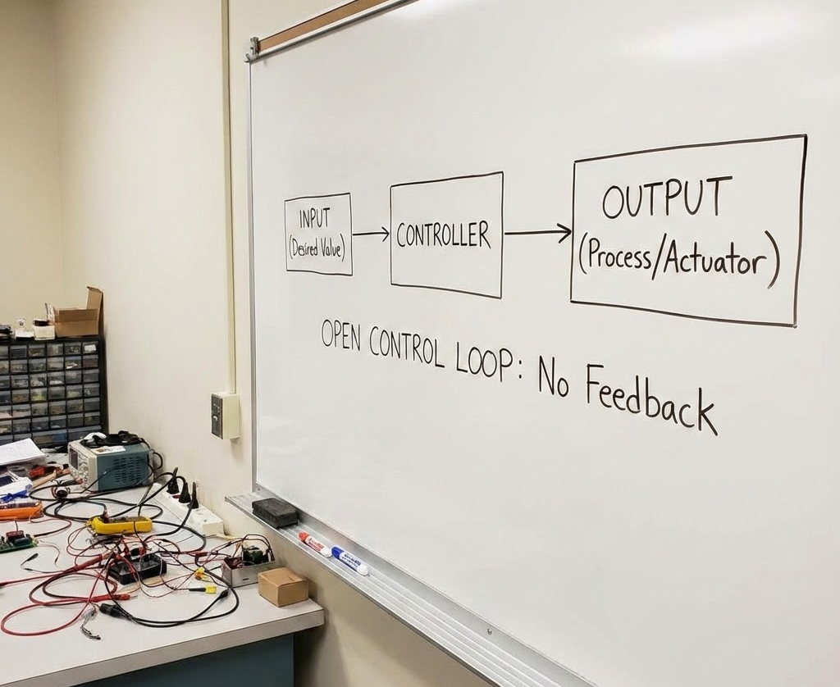
1. Open Loop Control
"Spray and Pray"
The control action is independent of the output.
Example: A lawn sprinkler timer.
It waters for 10 minutes regardless of whether it rained or the soil is already wet.
No Feedback: The system doesn't know if the job is done.
Simple, cheap, but inaccurate.

Slide 5

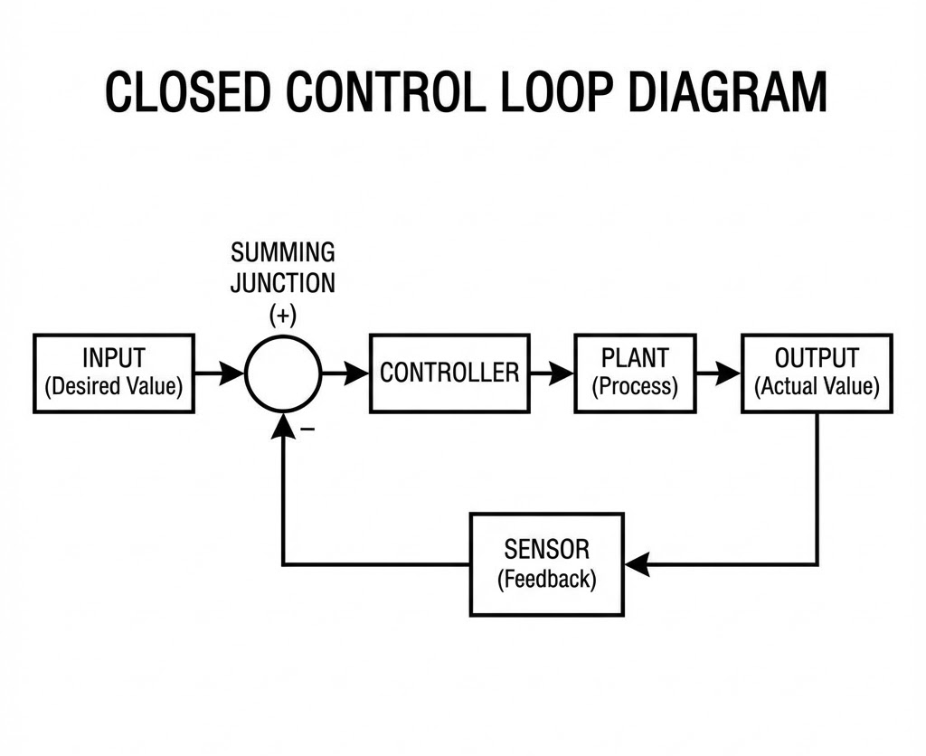
2. Closed Loop Control
"Feedback Control"
The control action depends on the output.
Example: A Soil Moisture based irrigation system.
The sensor reads the moisture.
The controller compares it to the Setpoint.
The pump runs until the setpoint is reached.
Accurate, robust, but more complex.

Slide 6
Comparison: Open vs. Closed Loop
Feature | Open Loop | Closed Loop
Feedback | None | Yes
Accuracy | Low (Depends on calibration) | High (Self-correcting)
Stability | Stable | Can be unstable (Oscillate)
Cost | Low | High (Sensors needed)

Slide 7


Anatomy of a Feedback Loop
The Controller
The Actuator
The "Brain" (Arduino/ECU). Calculates how much correction is needed based on the error.
The "Muscle" (Motor/Heater). Applies the correction.
The Plant
The Sensor
The "System" (Greenhouse/Engine). The physical thing being controlled.
The "Eye". Measures the actual state of the plant.

Slide 8
Types of Control: 1. On-Off
Logic
The Problem
If Error > 0, Turn ON (100%).
Rapid cycling (Chatter). If the setpoint is 25.0°C, it would switch off at 25.01 and on at 24.99.
If Error < 0, Turn OFF (0%).
This destroys motors and relays.
Example: A standard home iron or refrigerator.

Slide 9
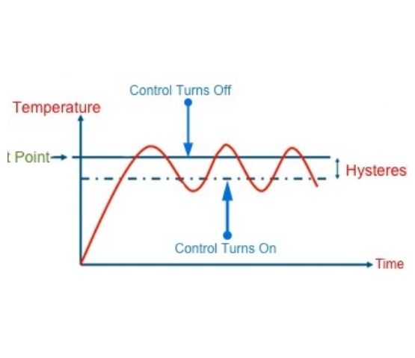
The Solution: Hysteresis
Adding a Deadband
We create a gap between the Turn-ON point and Turn-OFF point.
Setpoint: 25°C.
Turn ON: 23°C.
Turn OFF: 27°C.
This prevents rapid cycling but causes the temperature to oscillate (ripple) around the setpoint.

Slide 10

Types of Control: 2. PID Control
Proportional - Integral - Derivative
The "Gold Standard" of industrial control.
P
I
D
Present Error
Past Error
Future Error

Slide 11
Proportional (P) Control
Concept
The Flaw
The correction is proportional to the error.
Steady State Error: As the error gets small, the correction gets small.
Often, it's not enough to reach the exact setpoint (e.g., Drone hovering slightly below target height).
Big error = Big push. Small error = Small push.

Slide 12
Integral (I) Control
Concept
The Flaw
Sums up (Integrates) the error over time.
Wind-up & Overshoot: The accumulated error can cause the system to shoot past the target before recovering.
If a small error persists, the Integral term grows larger and larger until it forces the system to the setpoint.

Slide 13
Derivative (D) Control
Concept
The Flaw
Looks at the rate of change (Slope) of the error.
Noise Sensitivity: If the sensor signal is noisy (spikes), the derivative (slope) becomes huge, causing erratic control.
If the error is closing too fast, D applies the "brakes" to prevent overshoot.

Slide 14
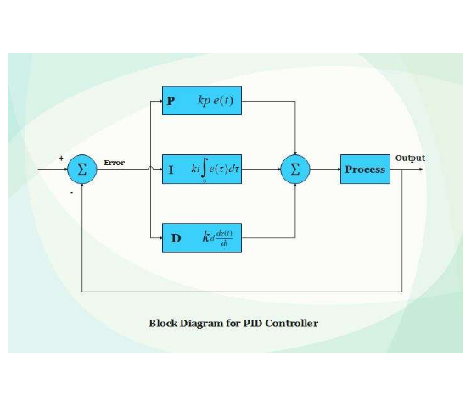

The Complete PID Loop
The output sent to the actuator is the sum of all three:
By "Tuning" , , and , we can achieve fast, stable, and accurate control.

Slide 15
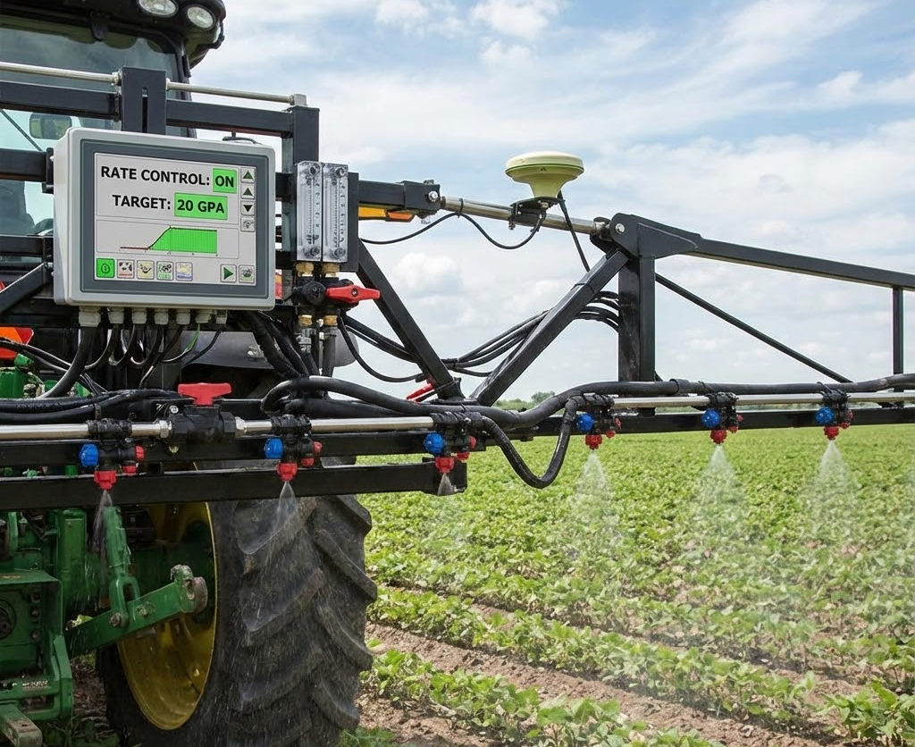
Ag App: Rate Controller
Precision Spraying
Objective: Maintain 200 L/ha regardless of tractor speed.
Sensor: Flow Meter.
Actuator: Control Valve (Motorized Ball Valve).
Controller: PID Loop.
If the tractor speeds up, the PID controller opens the valve to increase flow instantly.

Slide 16

Discussion & Questions
End of Lecture 11
Assignment: Explain why a Drone uses PID control for stability. What happens if the 'D' term is set to zero?
Dr. Kadeghe Fue | AGE 310 | SUA

